Slide 1
Perceptron: Linear ANN

Slide 2
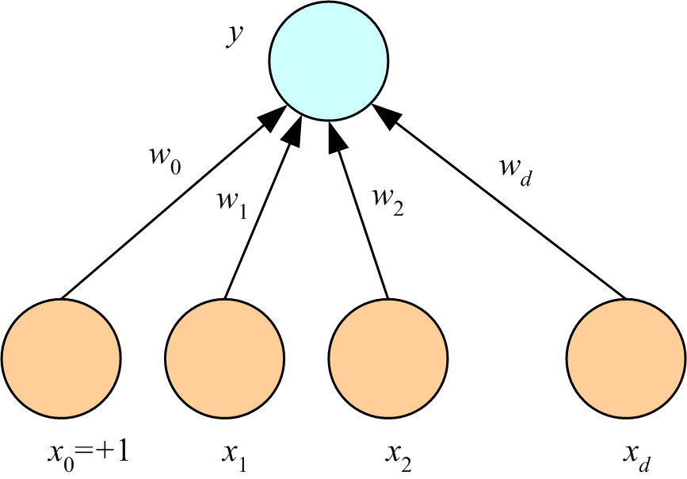
Multivariate linear models: the perceptron
1) linear classification
2) linear regression
3) logistic regression

Slide 3
Always start with a linear model:
If results meet performance criteria, publish!
A non-linear model may reduce E_{in} but probably
will not generalize as well
Are there any models less complex than linear?

Slide 4
All linear models optimize a linear combination of attributes
and a bias node equal to one.
If we include the bias node as component x₀ of the attribute
vector, x, then the linear combination can be written as the dot product w^{T}x where w is the weight vector
Think of the dot product as a way to generate a scalar signal, s,
from input data. The output node is processed differently to achieve different applications of the perceptron.

Slide 5
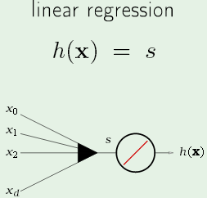
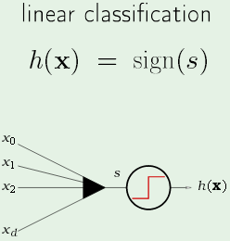
Perceptron applications
binary
w^{T}x compared to label
that is a real number
sign(w^{T}x) compared to
label that is +1

Slide 6
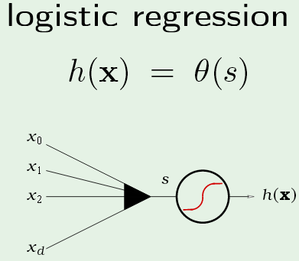
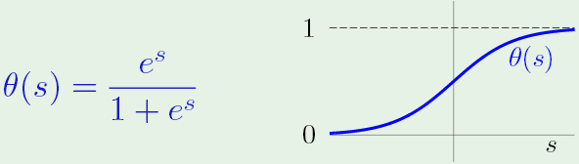
Use the signal as the argument
of a function with properties
like a probability distribution

Slide 7
Multi-class classification by
w^{T}x is compared to integer labels of classes
Bin the regression results to assign examples to classes
With labels {0,1}, assign to positive class if s > 0.5

Slide 8
Example: Linear binary classifer for loan approval/rejection
origin of the bias node
stochastic weight optimization

Slide 9
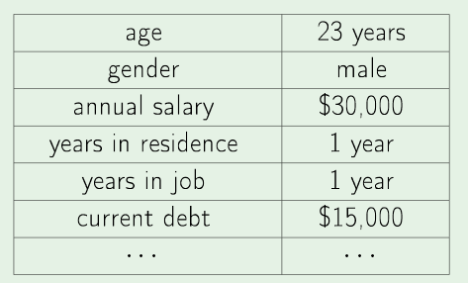
Real-world example: credit approval
Should loan be approved? (linear classification)
At what interest rate? (linear regression)
What is likelihood of default? (logistic regression)

Slide 10
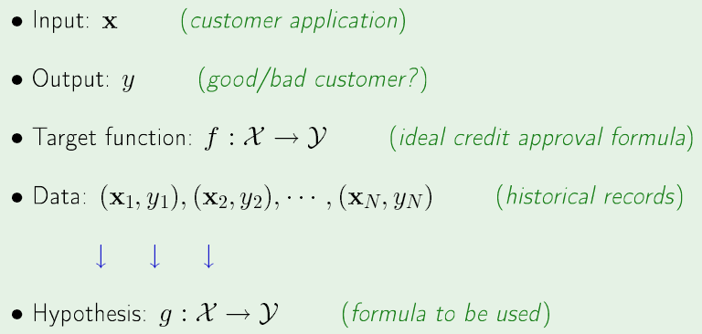
credit approval dichotomizer
Output is binary (+1 approve, -1 reject) Target function is unknown.
Hypothesis is a way to combine applicant attributes to calculate output Labels +1 required for stochastic weight optimization

Slide 11
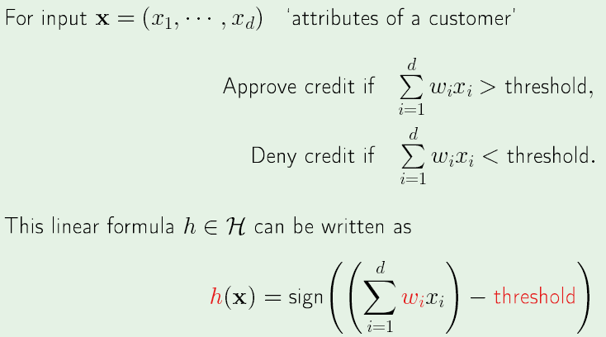
Bias node: Threshold for approval

Slide 12
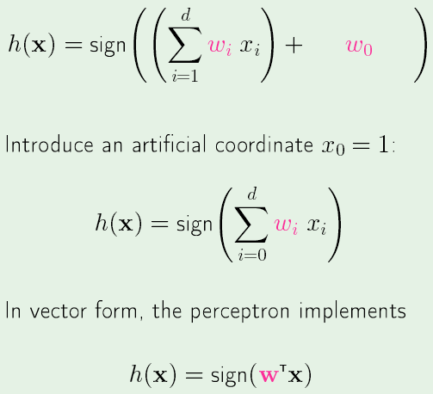
Include “threshold” into attribute vector

Slide 13
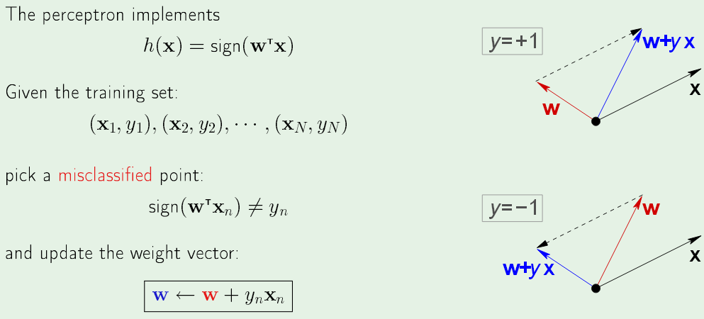
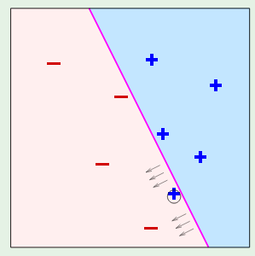
Perceptron learning algorithm (PLA)
sign(w^{T}x) negative
sign(w^{T}x) positive
Each iteration pulls boundary in direction that tends to correct misclassification

Slide 14
PLA is a stochastic optimizer
sign(w^{T}x) negative
sign(w^{T}x) positive
Correction for one misclassification may produce more misclassifications

Slide 15
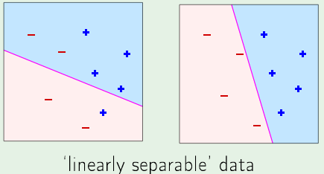
If data is linearly separable, iteration terminates when E_{in}(g) = 0
Otherwise terminates by maximum number of iterations
A graphical demo of the Perceptron Learning Algorithm (in Octave) is on AMLbook.com

Slide 16
Stochastic optimization useful when examples are processed “on the fly”
For batch processing, one-step optimization (multivariate linear regression
followed by binning) is faster and just as accurate.

Slide 17
Perceptron in 1D: What can it do?
Fit a line to data: y=wx+w₀
Use y=wx+w₀ as a discriminant
y
y
y
s
w₀
w
x
x
w₀
w
w₀
x
x
x₀=+1
S = sigmoid(y)
If y > 0 -> S > 0.5; chose green
otherwise chose red
Lecture Notes for E Alpaydın 2010 Introduction to Machine Learning 2e © The MIT Press (V1.0)
17

Slide 18
Perceptron can do the same things in dD
Fit plane to data and find a discriminant hyper-plane
x is input vector
w is weight vector
y = w^{T}x
What is illustrated here, regression or classification? Why is this question ambiguous?
18

Slide 19
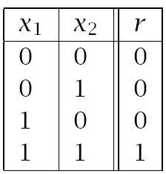
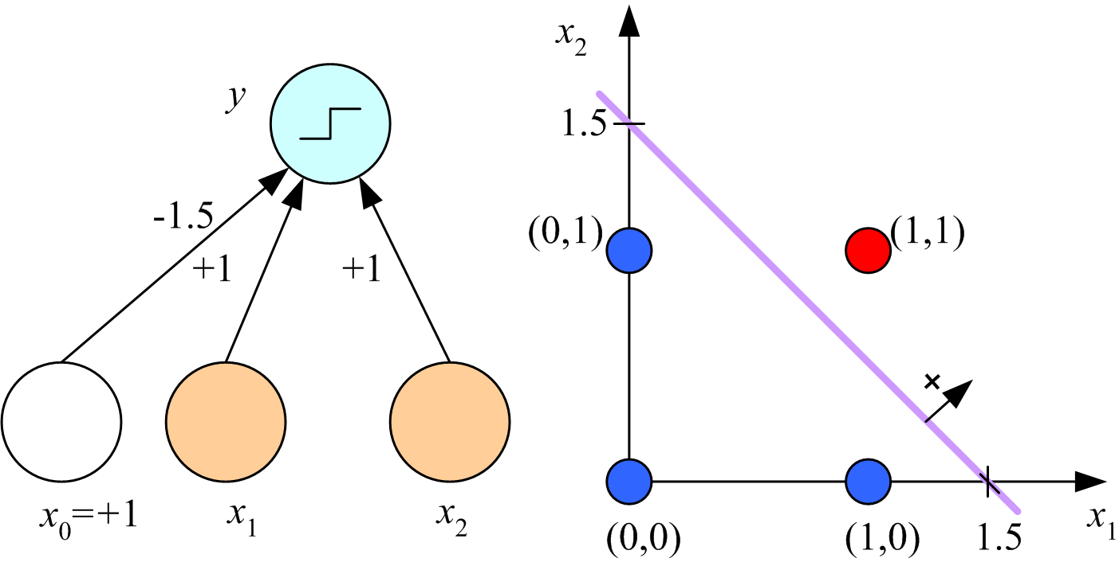
Boolean AND: Simple 2D classification problem
Find acceptable discriminant by hand calculations
S
data table
Lecture Notes for E Alpaydın 2010 Introduction to Machine Learning 2e © The MIT Press (V1.0)
19

Slide 20
Derive the linear discriminant x₁+ x₂ -1.5 = 0
Output is sigmoid(w^{T}x)
If w^{T}x << 0 → r = 0 if w^{T}x >> 0 → r = 1
x1 x2 r w^{T}x must be choice
0 0 0 w0 <0 w0=-1.5
0 1 0 w2 + w0 <0 w1= 1
1 0 0 w1 + w0 <0 w2= 1
1 1 1 w1 + w2 + w0>0
linear discriminant w^{T}x = 0
Lecture Notes for E Alpaydın 2010 Introduction to Machine Learning 2e © The MIT Press (V1.0)
20

Slide 21
Boolean AND: linearly separable 2D binary classification problem
S
data table
w^{T}x=0
Other linear discriminants are possible
We have not yet specified an optimization condition
Lecture Notes for E Alpaydın 2010 Introduction to Machine Learning 2e © The MIT Press (V1.0)
21

Slide 22
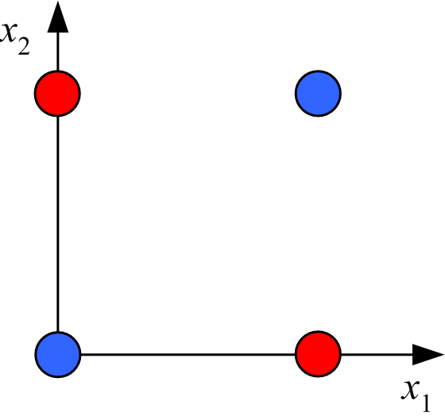
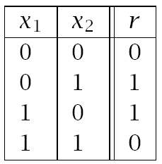
Boolean XOR: linearly inseparable 2D binary classification problem
data table
graphical representation
Application of perceptron not possible in attribute space
Solution: transform to linearly separable feature space

Slide 23
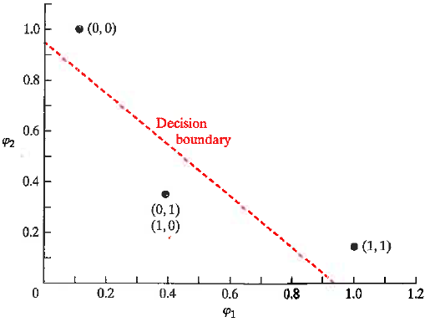
φ₁ = exp(-|X – [1,1]|²)
φ₂ = exp(-|X – [0,0]|²)
X φ₁ φ₂
(1,1) 1 0.1353
(0,1) 0.3678 0.3678
(0,0) 0.1353 1
(1,0) 0.3678 0.3678
XOR in Gaussian
Feature space
This transformation puts examples
(0,1) and (1,0) at the same point in
feature space
Perceptron could be applied to find
a linear discriminant

Slide 24
Nodes in hidden layer of multilayer perceptron (MLP) are equivalent to
feature-space transformation of input attributes

Slide 26
Perceptron: Neuron analogy to linear models for classification and regression
Dot product w^{T}x is a way of combining attributes with bias into a scalar signal s,
which is transformed in the output note to create the desired hypothesis set.
sigmoid(s)

